Slide 1

Probability of default
By An Nguyen, Darren Kim, Rakhi Roy, Kevin Swartz, Andrew Thao, Mehrdad Maleki

Slide 2
Probability of default
Probability of default (PD) is a financial term describing the likelihood of a default over a particular time horizon. It provides an estimate of the likelihood that a borrower will be unable to meet its debt obligations. PD is used in a variety of credit analyses and risk management frameworks. It is a key parameter used in the calculation of economic capital or regulatory capital for a banking institution. PD is closely linked to the expected loss, which is defined as the product of the PD, the loss given default (LGD) and the exposure at default (EAD).

Slide 3

Credit Risk
-The possibility that someone who has borrowed money will not repay it all.
-Calculated risk difference between lending someone money and a government bond.
-When someone fails to repay a loan it is said to be in default.
Higher the probability, higher the chance of default.

Slide 4
Data Source
https://www.kaggle.com/ranadeep/credit-risk-dataset

Slide 5





Technologies we used
Heroku
Python Pandas
Bootstrap
Flask
Tableau

Slide 6
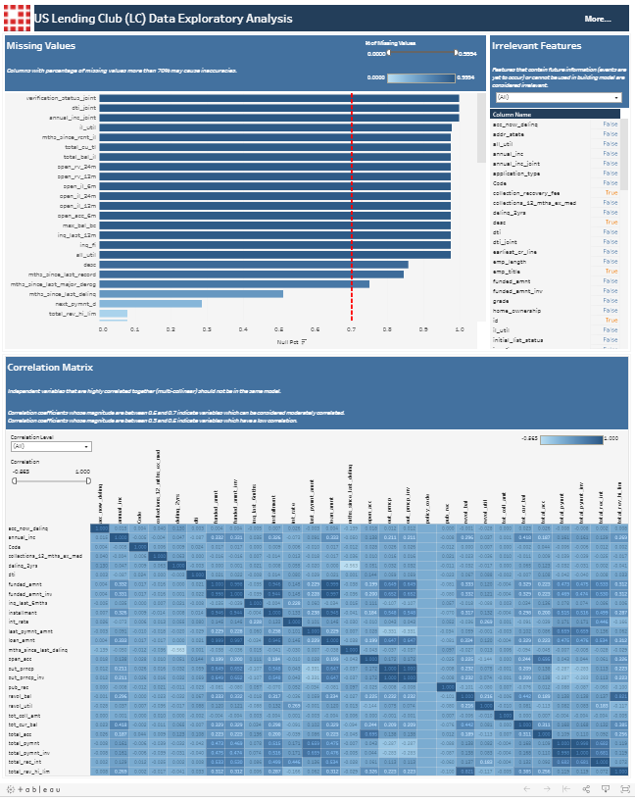
Exploratory Data Analysis

Slide 7
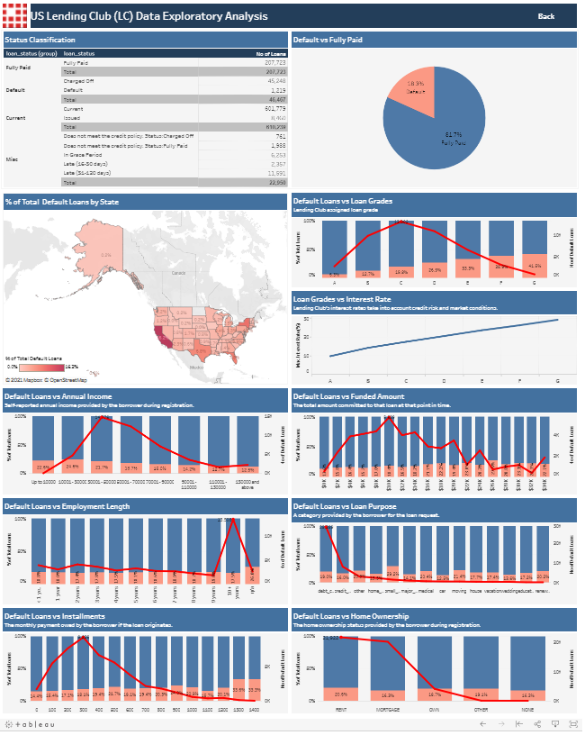

Slide 8
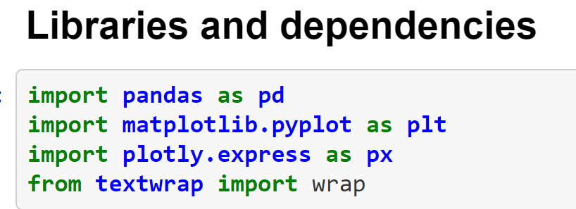
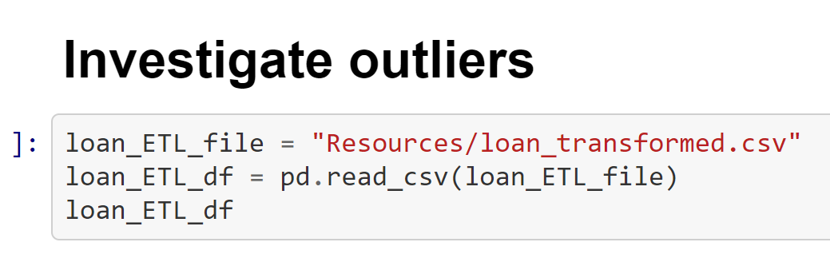
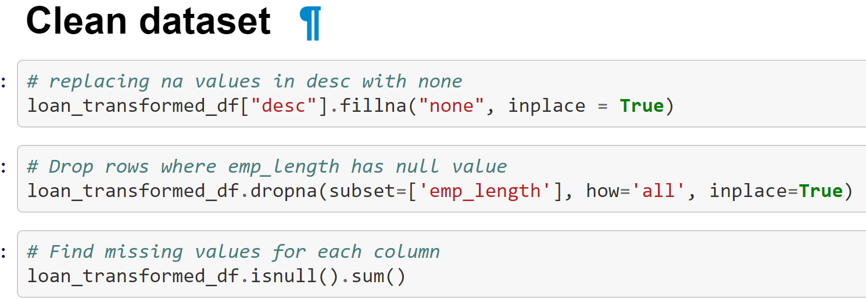
Cleaning and Grouping

Slide 9
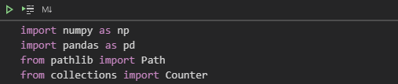
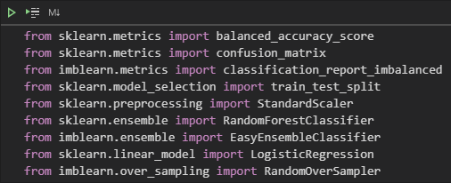
Machine learning Library

Slide 10
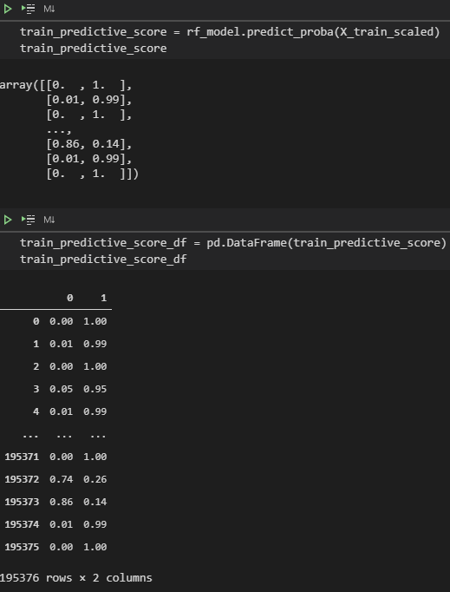
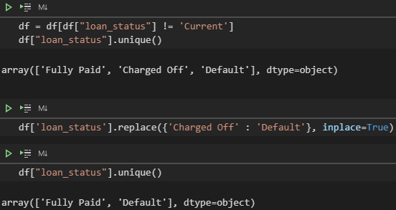

Slide 11
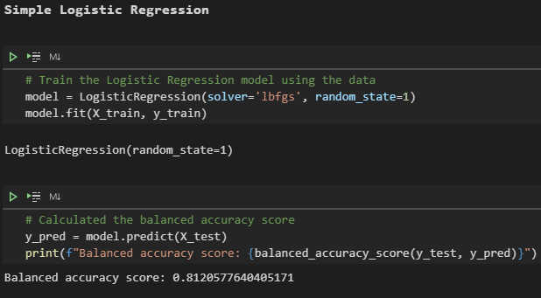
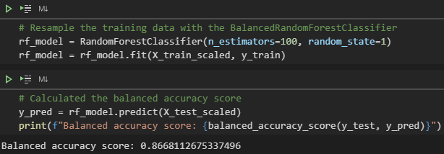

Slide 12

Front end
https://mbc-probability-of-default.herokuapp.com/

Slide 13
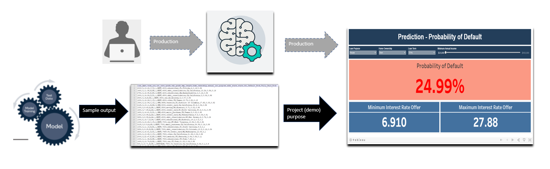
Predictions

Slide 14
Thank you

